Slide 1

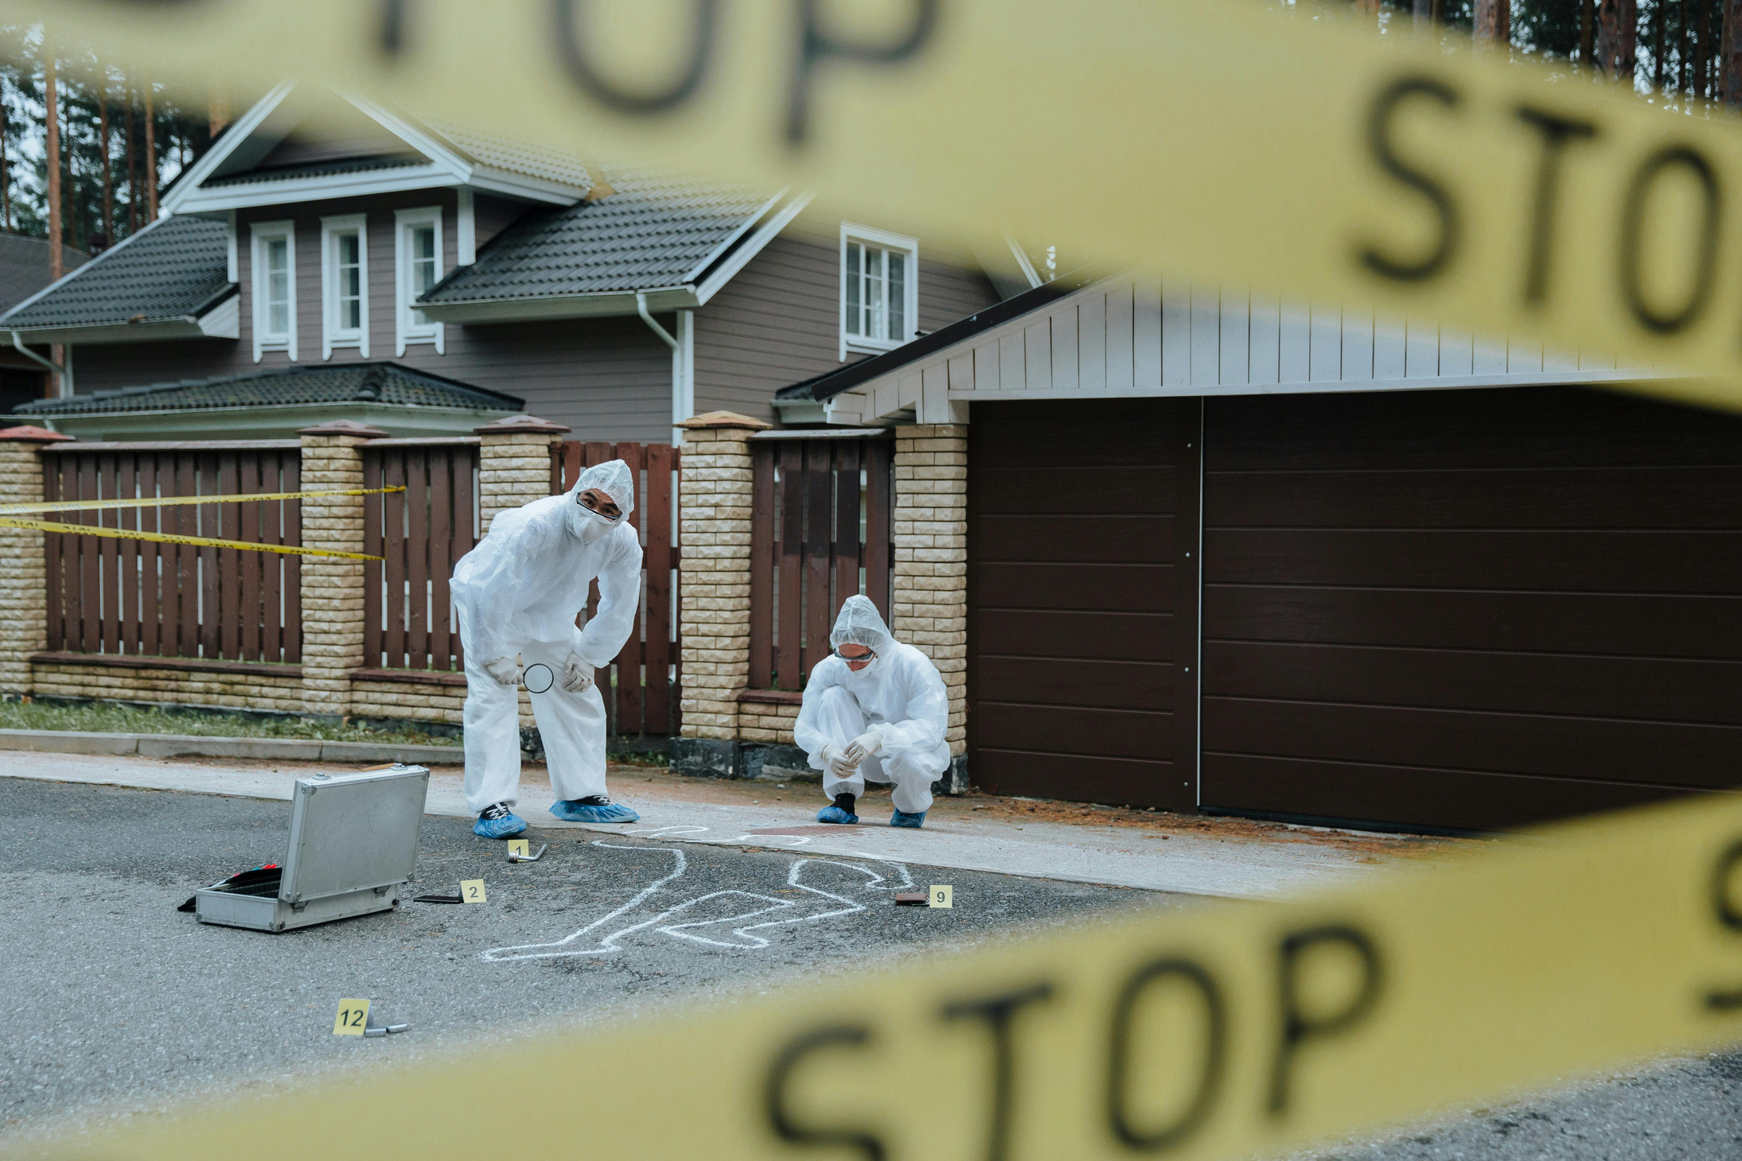
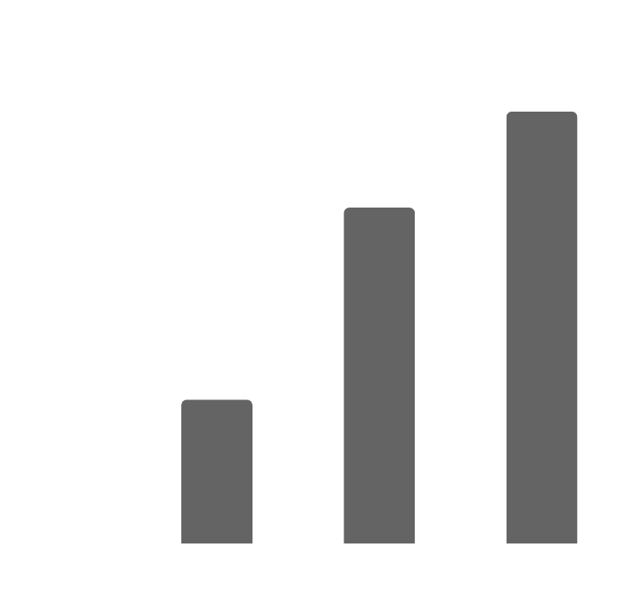

Neighbourhood Crime in Toronto

Slide 2

Justification of the Study
Crime rates have been on the rise over the years,
As such there is a need to identify trends and patterns as well as areas with more popular crime types to form awareness amongst individuals and enable them to take safety precautions, this could equally help influence settlement decisions. Also, knowledge of this will adequately help the necessary authorities in planning towards implementing safety measures for the affected public.

Slide 3


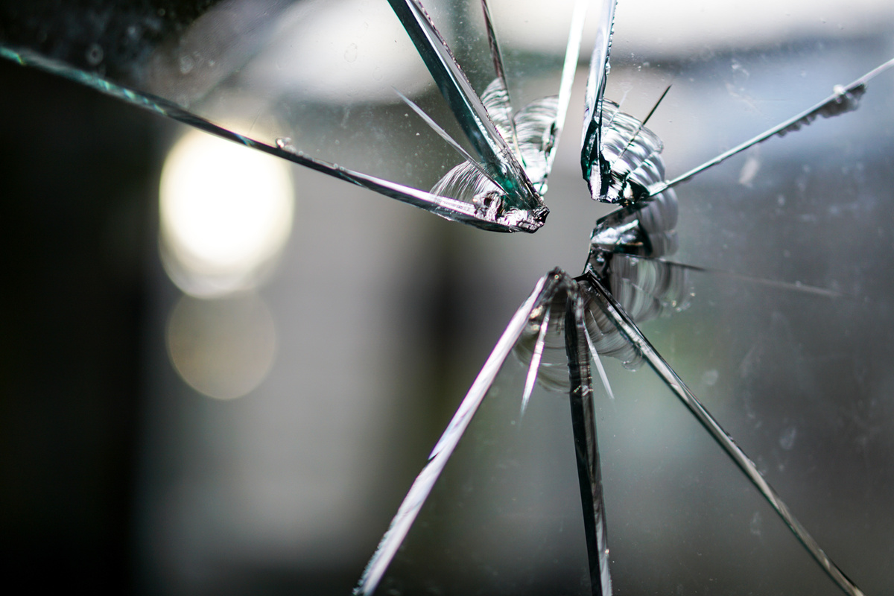


Introduction
This study looks at Neighborhood crime rate in Toronto with a focus on 4 crime metrics (Bike theft, Auto theft, Break enter and Shooting), a period of 9 years is being considered (2014-2023). Data for this analysis was derived from the Toronto Police Service Public
Safety Data Portal.
The limitation associated with this study revolves around the completeness and timeliness of the data set. This can be linked to the way the data is being reported, approximate and not exact location of crimes are being considered.

Slide 4
Introduction
For further analysis, the proportional distribution of each crime rate is looked at to answer the research question: What crime is most popular. A year-on-year analysis of the crimes is equally focused on establishing a pattern over time. This tries to answer if crimes are increasing or decreasing over the recorded years. This analysis made use of chart.js in making powerful visualizations to answer the research questions. Also data used for this analysis was housed in MongoDB.

Slide 5




Crime Rate Analysis
Understanding community safety trends

Slide 6

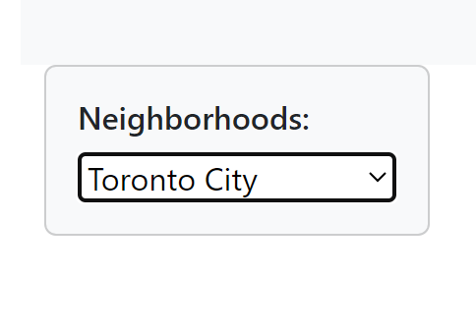
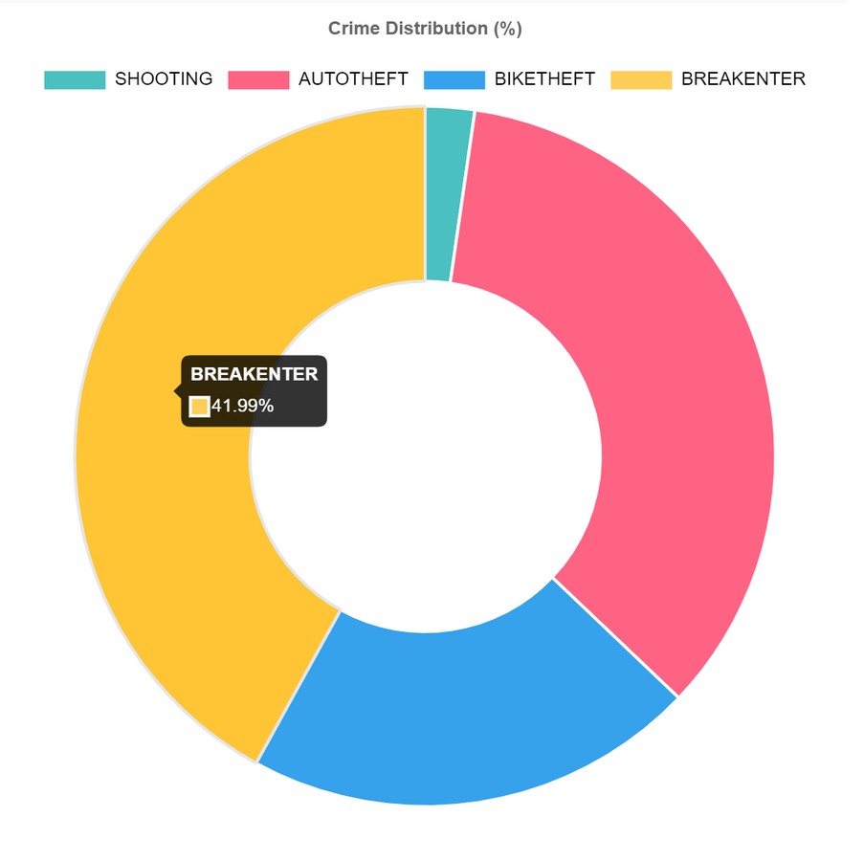
Crime Insights
Exploring Trends in Crime Rates Analysis
This doughnut chart uses the library chart.js.
This is the whole Toronto City data representation.
Overall shooting seems to be the lowest segment in most of the neighborhoods and breakenter seems to be the highest occurring crime.
This would be resourceful in finding which areas need more attention towards what crime and can aid in prevention and protection measures.

Slide 7
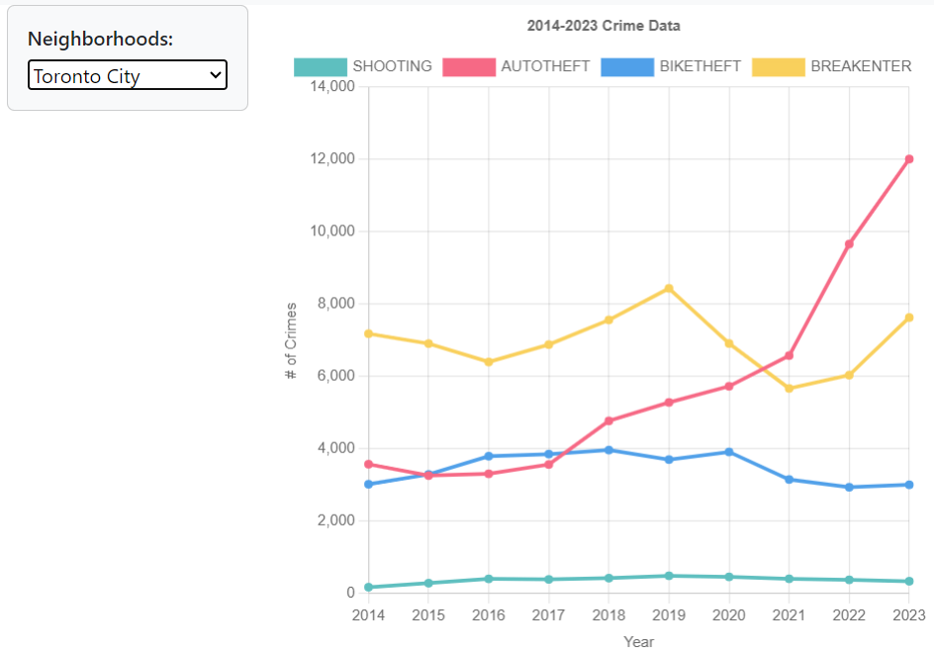
Impact of Crime Rates Over Time
Exploring trends in criminal activity across different regions.
Chart is selected to view the total of all the neighborhoods.
The line chart provides a comprehensive analysis of crime trends across different regions of Toronto, which can be valuable for individuals seeking to move into a new neighborhood
Highest crime is auto theft, then break and enter, bike theft and shooting

Slide 8
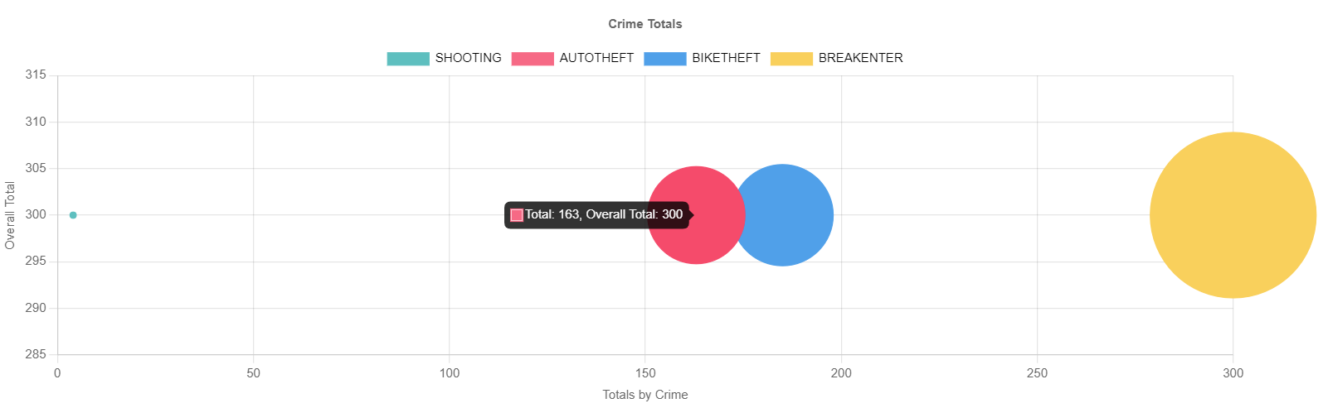

Crime Totals - Individual Crime Rates by area
Each bubble represents the magnitude of a particular crime rate, while the position of the bubble indicates its relationship Overall Total and the highest crime record for that given area.
We can observe that certain neighborhoods have significantly larger bubbles, indicating higher crime rates.
In some specific areas, we noticed clusters of bubbles, suggesting localized patterns of criminal activity.
Overall, the bubble chart provides valuable insights into crime distribution, helping us identify areas of concern and potentially informing resource allocation and crime prevention strategies.

Slide 9
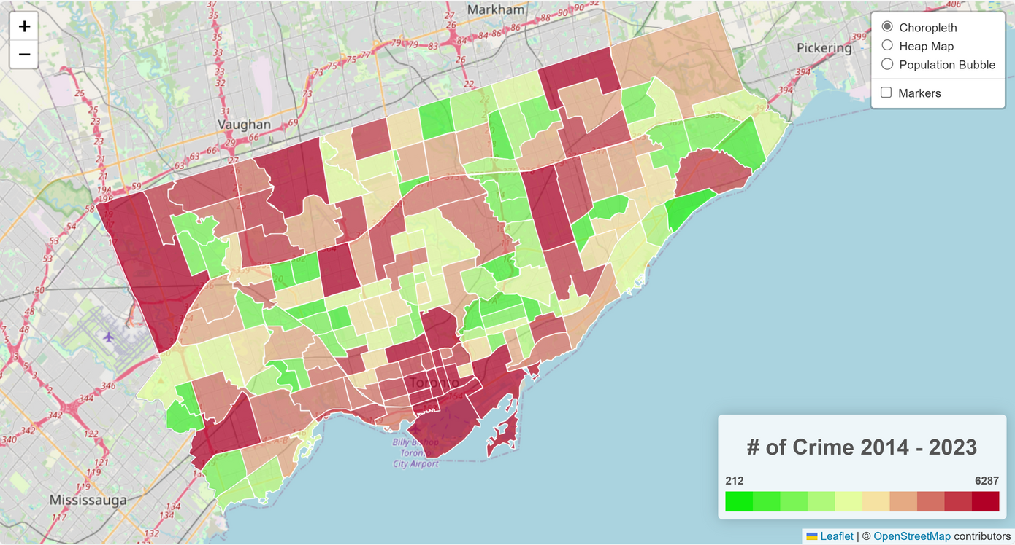
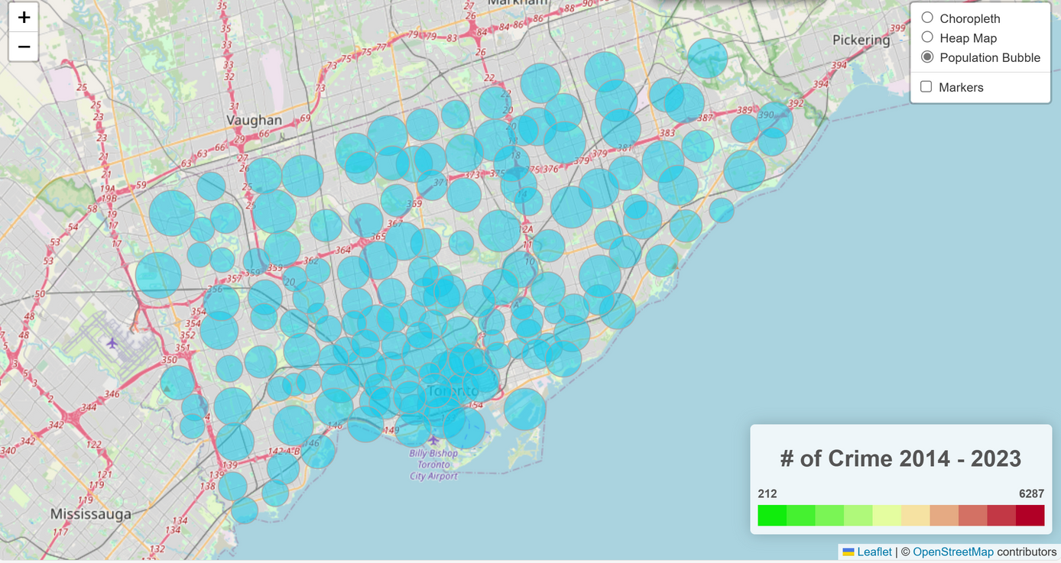
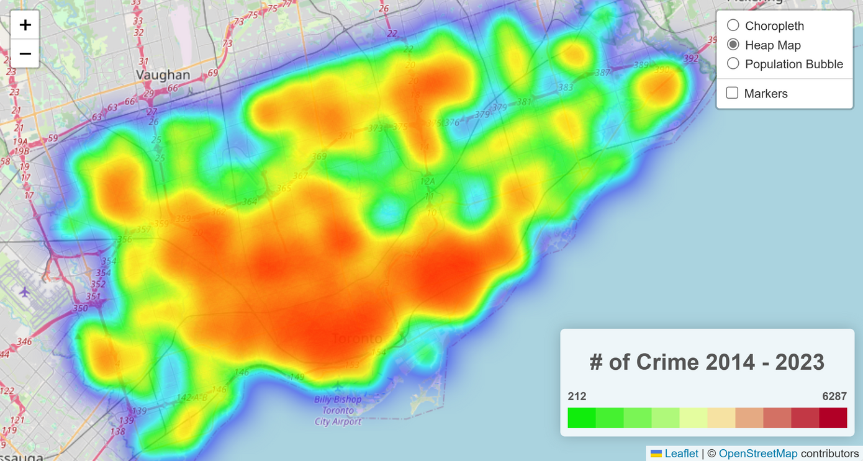
Our choropleth map clearly indicates which districts of Toronto has experienced the most and least crimes.
The bubbles on the map showcases the areas where crime occurs and defines the population density by its size.
The third map assists on better understanding the distribution (or density) from each area.

Slide 10
Conclusion
Results from the findings show that the Popularity of a certain crime is not constant across different neighborhoods examined. As such we can say a particular type of crime is associated with a particular neighborhood. This can be linked to other factors that influence crimes in neighborhoods. For instance, areas with more housing density are prone to break enters while areas with inadequate parking facilities will be more prone to auto theft. In general Break enters and Auto theft are the most popular crimes across neighborhoods and shooting comes in as the least. Also trends in crime rate show that
auto theft has been on the increase from 2017-2023. All other metrics maintain a fluctuating pattern over the years.

Slide 11
References
Dataset: Neighbourhood Crime Rates Open Data. (n.d.).
Source: Data.torontopolice.on.ca.
Retrieved March 6, 2024, from: https://data.torontopolice.on.ca/datasets/ea0cfecdb1de416884e6b0bf08a9e195_0/explore?location=43.680053%2C-79.355367%2C10.81
‌

Slide 12
Demo
Notes:
testet

